Slide 1
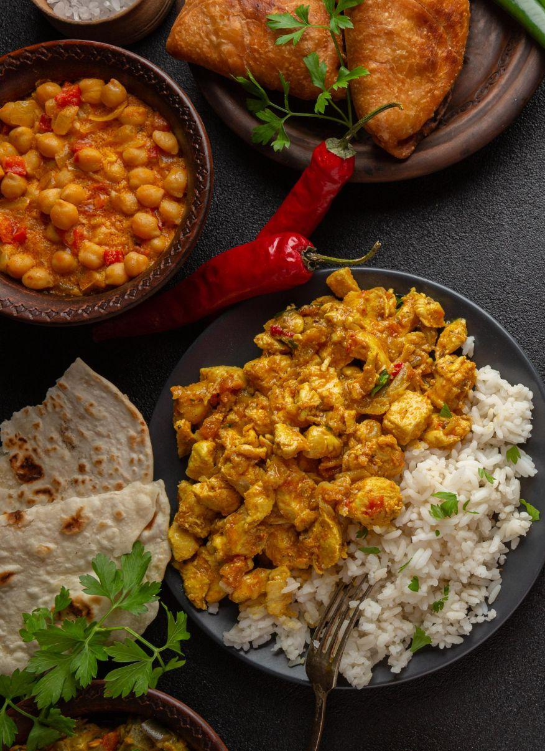
Amber India Optimization of decisions
Group 10: Rahul Rao Kandula, Sindhu Raghavendra Moktali, Siva Sai Chandra Annepu, Sri Krishna Chaitanya Kommalapati

Slide 2
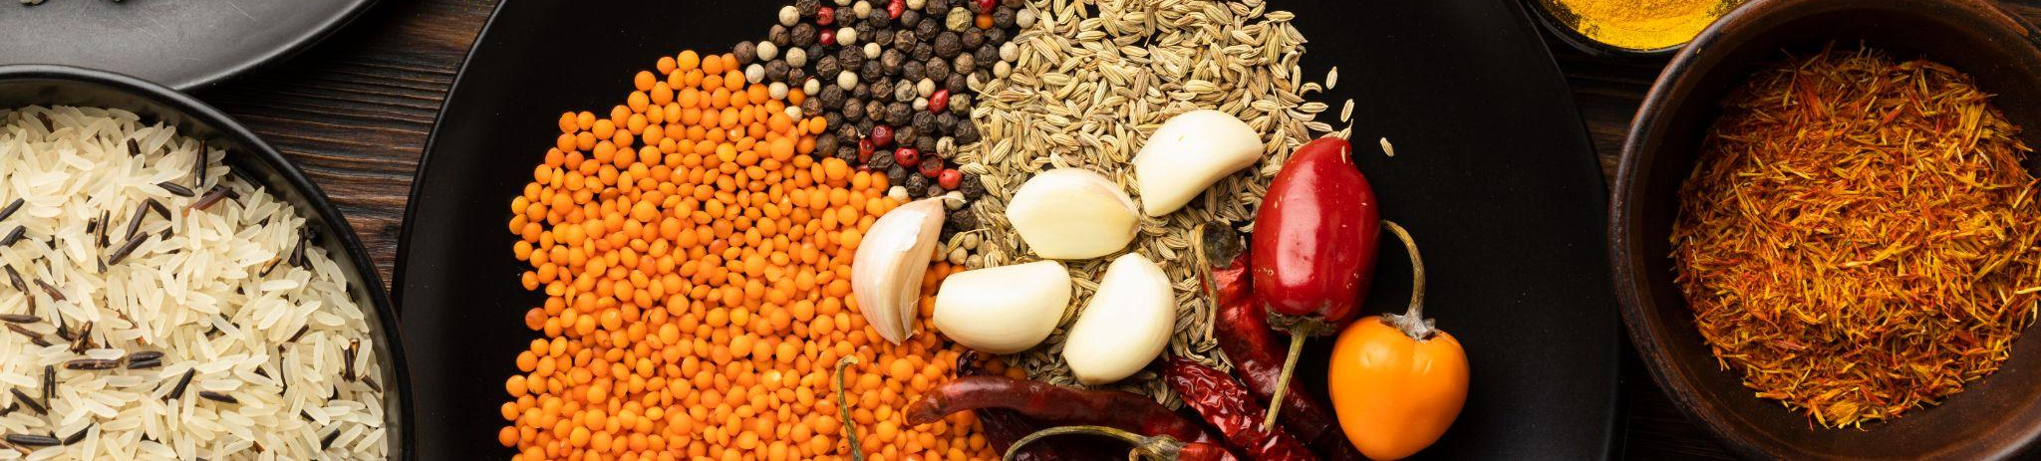
About Amber India
Amber India restaurants are award-winning restaurants with five locations across the San Francisco Bay Area at San Jose, Mountain View, Los Altos, Milpitas, and San Francisco. In addition to classical Indian cuisine, the restaurants also serve contemporary dishes. They offer a unique and innovative culinary experience at Amber's award-winning restaurants.

Slide 3
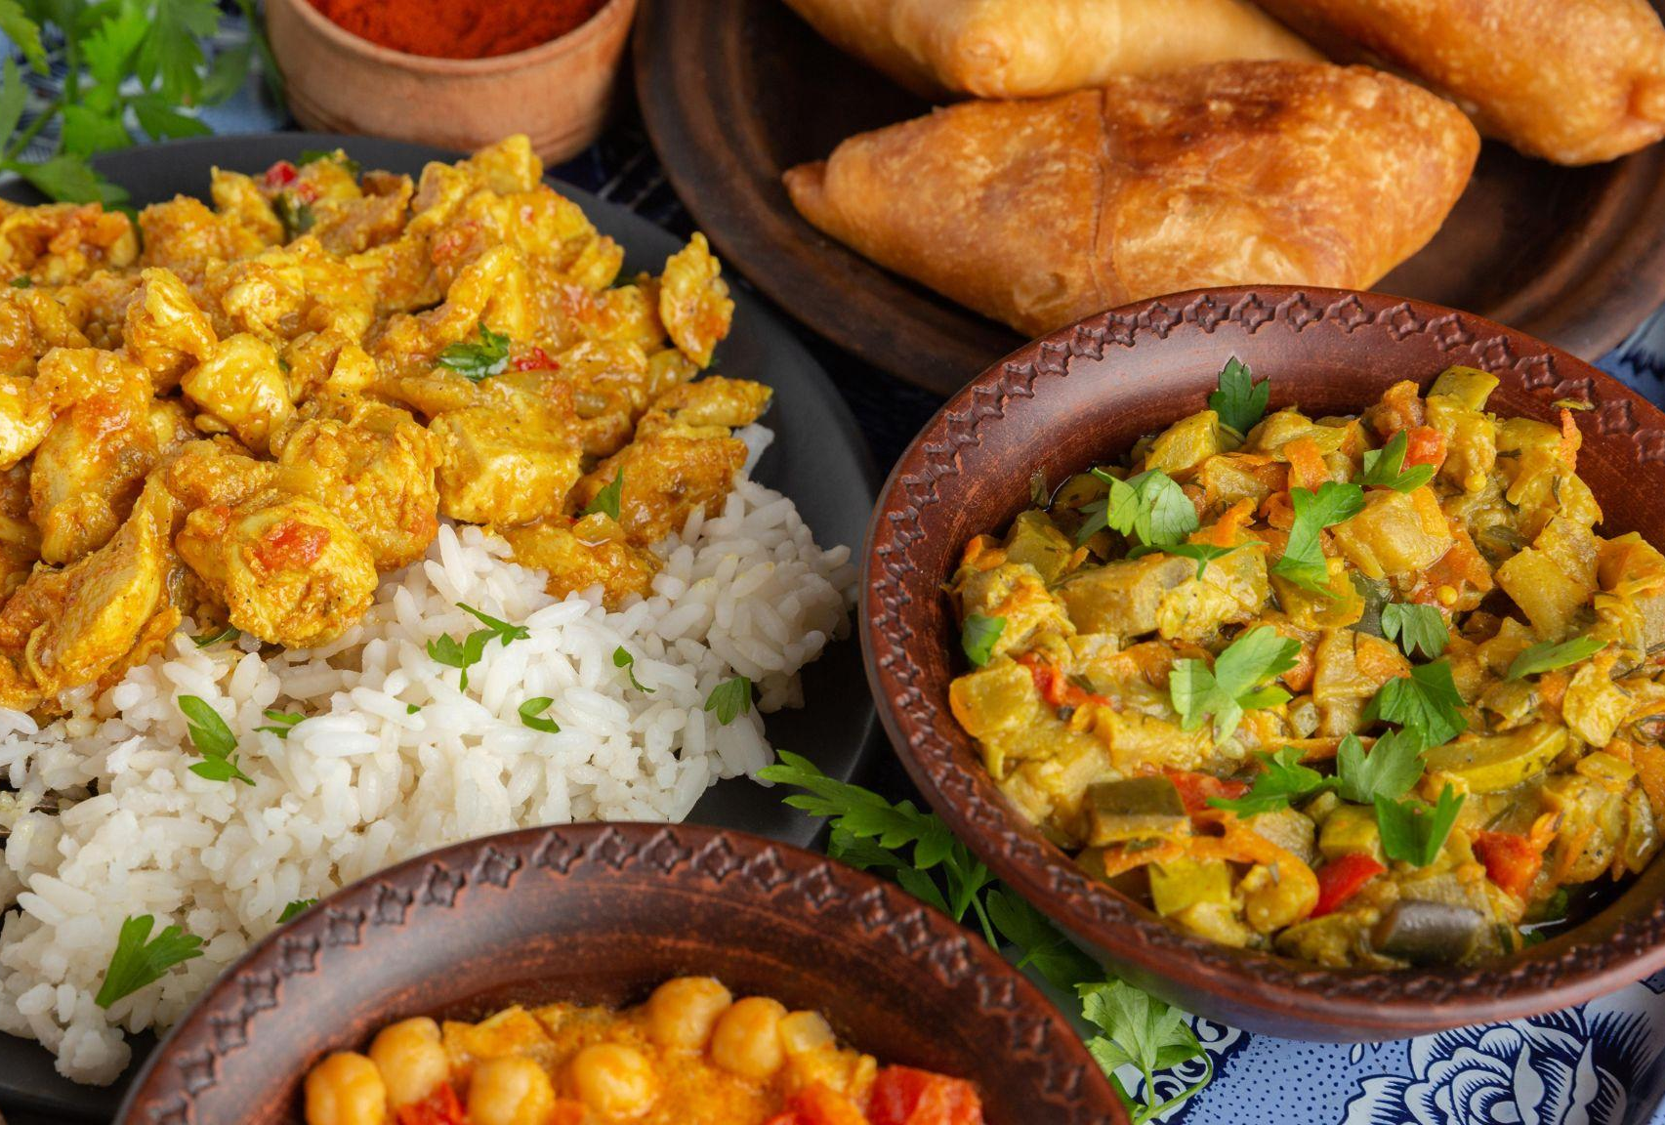
Goal
Amber has recently faced quite a reduced number of customers due to the Corona pandemic. The restaurateur and owner, Vijay Bist’s goal is to maximize Amber’s profits from sales.

Slide 4
Part 1
Maximizing The Number of Exposures of Ads

Slide 5
BayCreative’s advertising media
Medium 1
Television commercials on Bay-Area based TV stations.
Medium 2
Advertisements in food and family-oriented magazines.
Medium 3
Advertisements in major newspapers.

Slide 6
Our Mission:
Determine the decision variables
Formulate the optimization model with all the constraints
Coding in R, find the optimal number of advertisements to run in each media that maximize the expected number of exposures while satisfying all the constraints
1. What is the optimal profit value?
2. What are the optimal values for the variables?

Slide 7
Maximizing exposure
Decision Variables for tv, magazines and newspaper are taken as –
tv = No. of TV Ads
m = No. of Magazine Ads
n = No. of Newspaper Ads
Below are the target segments for the ads -
y = No. of people viewing at the young age range 18 - 30 years
ma = No. of people viewing at middle aged range 30 - 55 years
Constraints that are considered-
tv >= 0
m >= 0
n >= 0

Slide 8
Maximizing exposure
Framing the equation for ad costs:
$300,000* tv + $150,000*m + 100,000*n <=$4,000,000
Framing the equation for planning costs:
$90,000*tv +$30,000*m +40,000*n <=$1,000,000
Available Spots for TV commercials:
tv <=5
Expected Exposures are as below:
y >= 5M
ma >= 5M

Slide 9
Maximizing exposure
Using Table 2 , we translated to expected exposures based on the optimal ads as -
1.2M*tv + 0.2M*m >= 5M(For y)
0.5M*tv + 0.2M*m + 0.2M*n >= 5M(For ma)
We know that the expected exposures for each medium from Table 1 as -
tv * (1.2M*y + 0.5M*ma) >= 1.3M
m*(0.2M*y + 0.2M*ma) >= 0.6M
n*(0.2M*ma ) >= 0.5M
Expected Total Exposures = 1.3M*tv + 0.6M*m +0.5M*n
Cost of promotions can be formulated as -
$40,000*m + $120,000*n = $1,490,000
Maximizing the equation -> 1.3M * tv + 0.6M * m + 0.5M * n which is subject to -
$40,000*m + $120,000*n = $1,490,000
1.2M*tv + 0.2M*m >= 5M
0.5M*tv + 0.2M*m + 0.2m *n >= 5M and,
0 <= tv <= 5, m >= 0, n >= 0

Slide 10
Maximizing exposure
Using a Two-Phase Method, we found the initial value for optimization with dummy variables.
The initial values we found were -3.0245999, 8.886762, 9.4544127. We used those initial values for the actual optimization.
The optimal values are -
We used R to find the values of the equations.
TV ads | 2.3181818
Magazine ads | 17.6818182
Newspaper ads | 6.5227273

Slide 11
Part 2
Maximizing Profits

Slide 12
Questions to address:
What are the optimal profit value?
From Part I, we formulate the total profit as per Vijay:
Approximation of profit ~ Exposures = 1300000*tv + 600000*m + 500000*n
Now, we use ‘R’ to determine the optimal number of ads to run in each medium to maximize the total profit while satisfying all the constraints in Part1.

Slide 13
Questions to address:
What are the optimal values for the variables?
From Part I, we formulate the total profit as per Vijay:
Approximation of profit ~ Exposures = 1300000*tv + 600000*m + 500000*n
Now, we use R to determine the optimal number of ads to run in each medium to maximize the total profit while satisfying all the constraints in Part I.
tv = the number of TV commercials = 2.318182
m = the number of magazine ads = 17.681818
n= the number of newspaper ad = 6.522727

Slide 14
Maximizing profits
We will use fractions -
first_n =-0.0321*(n^2) + 0.706*n - 0.09
first_visit = (first_visit_tv + first_visit_mag + first_visit_np)*1000000
Given that, Profit earned per customer is $5, hence, Total Profit = first_visit * 5
From Part I, we have the costs for running the Advertisements and Planning.
ad_cost = 300000*tv + 150000*m + 100000*n
planning_cost = 90000*tv + 30000*m + 40000*n
Since these costs are not included in the Total Profit, we need to account for them to get the Net Profit earned by Amber India.
net_profit = Total Profit – Cost of ad – Cost of planning
$29,493,603 is the Net Profit based on calculations in R using the optimal values of variables we achieved in Part 1.

Slide 15
Questions to address:
Based on your calculation, what can you conclude about the accuracy of Vijay's approximation in Part I (i.e., finding the optimal variables by using the expected number of exposures)?
Comparing Vijay's approximation of Profit: The expected number of exposures is a rough approximation for profit. The expected exposures is given in Part 1:
Exposures = 1300000*tv + 600000*m + 500000*n = 16884090.9
Plugging in the values, we get 16884090.9, which would mean approximate profit is $16,884,091
The $16.8M profit is way off from the $29.5M optimal profit we got in part 2a. Thus, while the approximation may work for a small number, its error gets magnified when we are dealing with numbers in millions.

Slide 16
Part 3
Managing demand for Amour du Jour

Slide 17
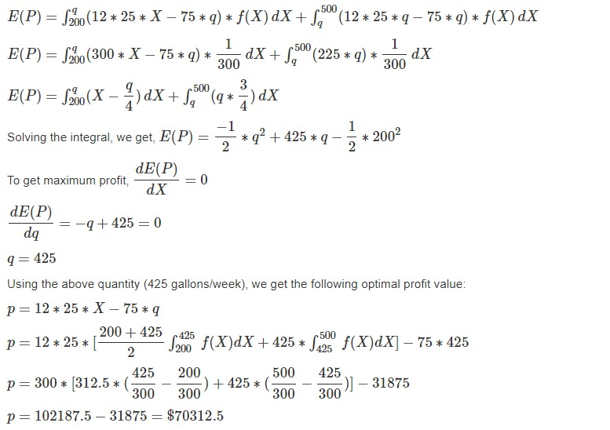
Maximizing demand

Slide 18
Questions to address:
What are the optimal values for the variables?
The optimal number of gallons of Amour du jour for which Amber must order raw materials
Each week to maximize its profit is 425 Gallons.
The optimal profit is $70,312.5

Slide 19
Questions to address:
What is the decision variable?
Decision variables are -
q = order qty of Amour du jour (in gallons)
X = customer demand of of Amour du jour (in gallons)
a = lower bound of weekly customer demand = 200
b = upper bound of weekly customer demand = 500

Slide 20
Questions to address:
Determine the optimal number of gallons of Amour du jour for which Amber must order raw materials each week to maximize the restaurant’s profit. What is the optimal profit?
Profit Function:
Profit = P = Revenue – Cost
P(X,q) = 12*25*x - 75*q; when X <= q
= 12*25*q - 75*q; when X > q
Given that we have a uniform distribution of the demand, the probability density function of the demand X is f(X). Using the formula:
f(X) = 1/(b-a) = 1/(500-200) = 1/300, if 200 <= x <= 500 , 0 otherwise.

Slide 21
Managing demand
On the left, we calculate the expectation of profit, E(P).
Optimal number of gallons is 425 gallons per week.
Therefore, optimal profit by Amour du Jour = $70312 per week

Slide 22
Thank you!

